Slide 1
Title: Deep Bayesian Active Learning with Image Data
Machine learning ||: Bayesian & Unsupervised Methods
Research Paper presentation
Presented by:
Alexander poppe
Pramod kumar Nagaraj
Research paper author:
Yarin Gal
Riashat Islam
Zoubin Ghahramani

Slide 2
Context
Majority of machine learning models built under supervised
Data hand labelled and Collect the labels via feedback mechanism
Samples to be labelled
Label all of them - get very expensive
Label randomly - cause redundant
Concept of active learning
Implementing an Active learning based approach to choose samples from unlabelled dataset provides the most value. Recent advance in Bayesian deep learning regarding extracting reliable uncertainty estimates from Neural network into Active learning

Slide 3
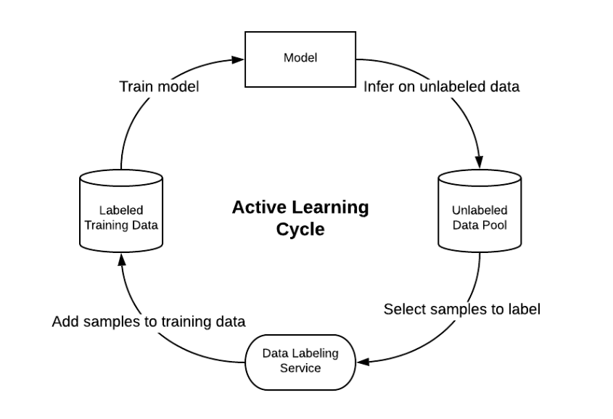
Active learning
Proactively select a subset of sample
Better performance with fewer labelled samples
Step : Picking sample to be labelled ? How ?
Results uncertainty. How to measure ?
Active learning cycle
Small sample get labelled
Train a model on labelled
Use train model to select unlabelled samples
Add label samples to training dataset
Repeat

Slide 4
Measuring Uncertainty and Gaussian process
Simple way, just look at the output of model
Neural network use softmax function
Using softmax function model sometimes can be uncertain about prediction
Other option: Gaussian process
Gaussian process uses a non-parametric approach
non -parametric approach results high dimensional spaces
To overcome these we use Deep Gaussian process

Slide 5
Bayesian Deep learning / CNN
Concept of Dropout
Dropout applied only during training section
Garin et al showed Dropout in NN is identical to variational inference in Gaussian process
Method of Monte carlo dropout
Example : Categorizing cat and dog result 40% cat, 30% dog. 30% neither

Slide 6
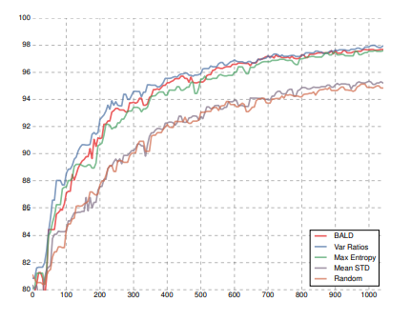
Connecting ….! Active learning
Recall
Using monte carlo dropout we can make multiple prediction for each unlabeled samples and use them to extract uncertainty estimates.
Regression: Choose samples with high predictive variance to be labelled
Classification: Use acquisition function. BALD gives best score.
Next code………….!

Slide 7

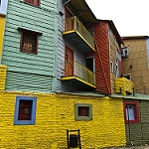
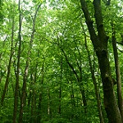

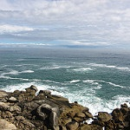
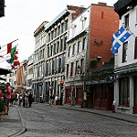
Our code

Slide 8
Acquisition functions – Var ratio
Labelled Set L, Unlabelled set U
Train Model
For X do:
take a sample from the unlabelled pool
For Number of predictions do
predict values of unlabelled sample
gather these samples
Predict var ratio’s
add the 10 best data points to labelled data set
train on labelled data set

Slide 9
Acquisition functions – Var ratio
p1
p2
pn
Data 1
Data 2
…
…
Data m

Slide 10

Acquisition function - BALD

Slide 11
Acquisition function - BALD

Slide 12
Comparison to current active learning technique
Compare to sparse existing literature of active learning with image data, which relies of the kernel method and further leverages the unlabelled datasets.
Evaluate RBF (Radial basis function) kernel over the raw images to get a similarity graph which can be used to share information about unlabeled data
Result expected to get minimised classification error which is referred as MBR (Minimum Bayes Risk)
MBR is for binary classification case. So they compare to acquisition functions and they experimented with CNN version for MBR and the was not good.

Slide 13
Compared to semi-supervised learning
In semi-supervised learning a model is given with a fixed set of labelled and unlabelled datasets.
The model can use the unlabelled dataset to learn about distribution of input that might help with mapping to the output
Several semi-supervised model which have set benchmark on MNIST given small number of labelled data (1k) and validation dataset (5K) and set of unlabelled data (huge) tuning hyperparameters and model structure. They compare to semi-supervised models which use a similar model structure of AL

Slide 14
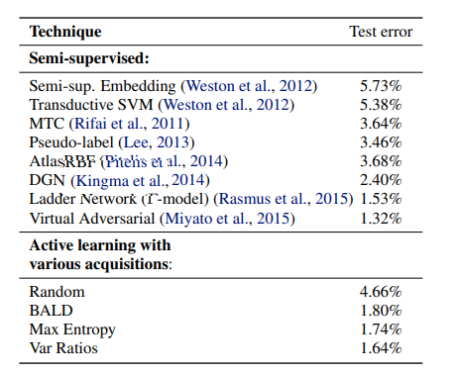

Slide 15
Future….!
What is interesting data to label ? (When model is uncertain)
Active learning in real-world medical applications
Much more

Slide 16


